Slide 1

Department of Computer Science And Engineering
SOLEMATE ELECTRONIC SHOES TO ASSIST VISUALLY CHALLENGED
Prepared By:-
Aaditya Raj(1ME20CS001)
Tasmia Kowsar(1ME20CS046)
Thaseen S(1ME20CS047)
Under the guidance of :
Dr. Malatesh S H
Prof. and H.O.D. CSE Department

Slide 2
Table of contents
02
Literature Survey
Problem Statement
01
Introduction
03
System Architecture
05
Algorithms analysis
04
Objectives
06
References and Conclusion
07

Slide 3
Introduction
01

Slide 4
Imagine navigating the world without sight, where every step holds uncertainty. Now, imagine a future where electronic shoes become your eyes, guiding you with invisible whispers and vibration. This is the promise of SoleMate, a revolutionary project crafting intelligent footwear that empowers visually challenged individuals to walk with newfound confidence and independence.

Slide 5
Literature Survey
02

Slide 6
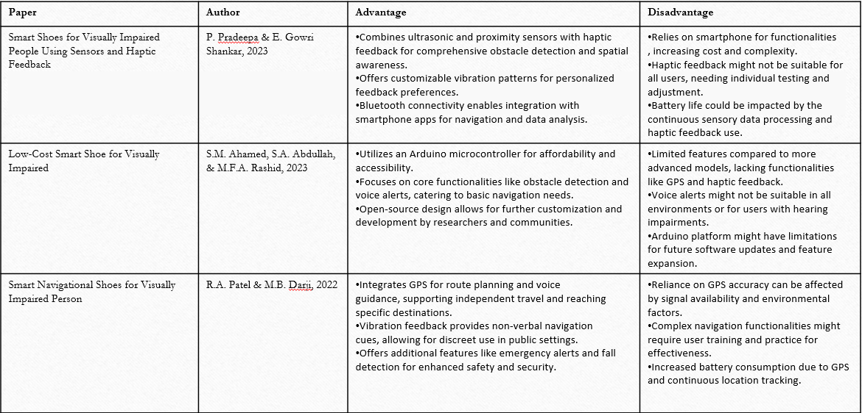
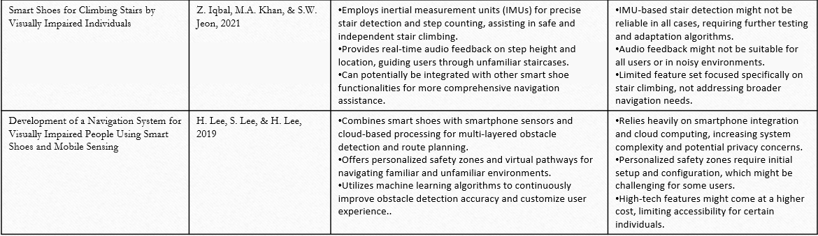

Slide 7
Problem Statement
03

Slide 8
Problem statement
We want a system that eliminates these challenges and provides awareness of surrounding , accessibility information , feedback to guide which provides confidence to navigate alone

Slide 9
System Architecture
03

Slide 10
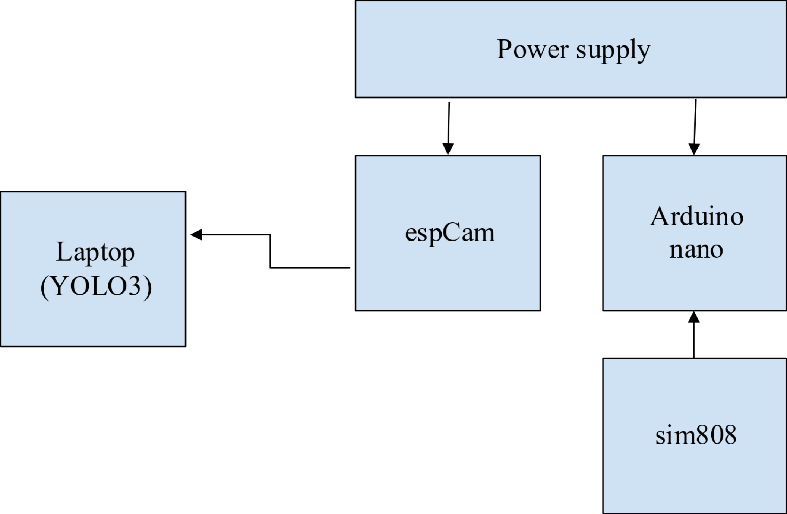
System Architecture

Slide 11
Objectives
04

Slide 12
Analysis and study for Electronic assisted shoe for visually challenged
Modules formation
Algorithm analysis

Slide 13
Modules
05

Slide 14
Modules
Dataset Collection
Data Pre-Processing
Training Network
Hardware Integration
Arduino Programing

Slide 15
Dataset Collection
We are using the YOLO algorithm to detect the object in real time .
Collecting a dataset for training a YOLO (You Only Look Once) model involves several
key steps to ensure that the model learns to accurately detect objects of interest. Here's a
brief overview of the dataset collection process. It includes:
Define Object Classes
Gather Images
Annotation

Slide 16
Data Pre-Processing
Data preprocessing for YOLO (You Only Look Once) involves preparing the dataset in a
format suitable for training the YOLO object detection model. Here are the key steps
involved in data preprocessing for YOLO:
Convert Annotations to YOLO Format
Augmentation
Split Dataset
Generate Configuration Files

Slide 17
Training Network
After preprocessing of data for YOLO , we can now proceed to train our network. The
goal here is to detect the object and recognise them in real time.
The process involve following steps
Training Process
Training Model
Evaluation Metrics

Slide 18
Hardware Integration
Integrating hardware components involves combining sensors, actuators,
microcontrollers, and feedback mechanisms to create a functional and user-friendly
device. Here's an overview of the hardware integration process for an Arduino-based shoe
for the blind:
Sensor Selection
Microcontroller Selection
Hardware Components
Power Supply
Sensor Placement
Wiring and Connections

Slide 19
Arduino Programing
Arduino programming involves writing code in the Arduino Integrated Development Environment (IDE) to control Arduino microcontroller boards. The programming language used for Arduino is a simplified version of C/C++.

Slide 20
Algorithm analysis
06

Slide 21
Why yolo?
YOLO, short for "You Only Look Once," is a real-time object detection system that has gained widespread popularity for its efficiency and accuracy. YOLO is known for its ability to detect and classify objects in images or video frames in a single pass. This is in contrast to traditional object detection algorithms that often involve multiple stages, making YOLO significantly faster.

Slide 22
Working of YOLO Algorithm
The YOLO algorithm works by dividing an input image into a grid and predicting bounding boxes, class probabilities, and objectness scores for each grid cell. The algorithm predicts these parameters directly, and the output is a set of bounding boxes with associated class probabilities, all achieved in a single forward pass through the neural network.

Slide 23
Reference and Conclusion
07

Slide 24
Reference
[1] Calder, David J, Curtin, “An obstacle signaling sytem for the blind, Digital Ecosystems and Technologies,”Confrence (DEST), 2011 Proceedings of the 5 th IEEE International Confrence on 30 June 2011.
[2] ShrutiDambgare, Prof.A.Sakhare,”Smart Stick for Blind: Obstacle Dection,Artificial Vision and Real- Time assistance via GPS” Confrence (NCICT)2011, Proceedings 2nd National Conference on Information and Communication Technology 2011.
[3] Rohithseth “Smart White Cane- an elegant and economic walking aid”.

Slide 25
Conclusion
SoleMate isn't just a pair of shoes; it's a revolutionary leap towards a more inclusive and empowered future. It's a whisper of possibility for millions who navigate a world designed for sight, a technological bridge towards independent mobility and confident strides.
This isn't just a project; it's a movement. Every individual who joins, every challenge overcome, every step taken with confidence paves the way for a brighter tomorrow. A future where everyone can walk with their heads held high, their own internal cartographer guiding them, their soles whispering the secrets of a world waiting to be explored.

Slide 26
Thanks!

